Slide 1



Unit 7: TOURISM
Lesson 7D: GRAMMAR

Slide 2
Reported speech
7D
I can use reported speech.
Student Book – page 86

Slide 3
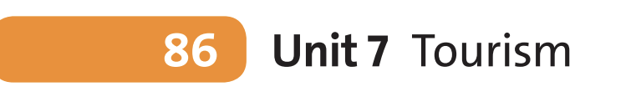


Lead-in
Do you have a twin brother/ sister?
OR
Do you know any twin in your life?
Are they identical?
Do they dress the same?
Do they like similar things?
Let’s discuss!
www.phuongnam.edu.vn

Slide 4
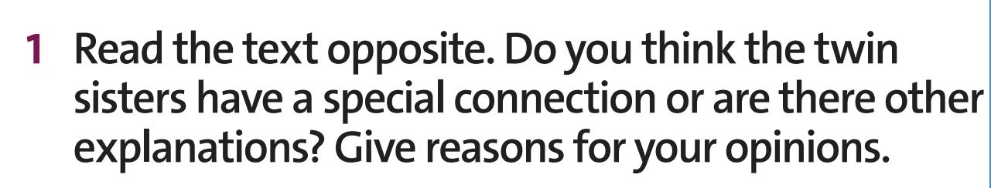
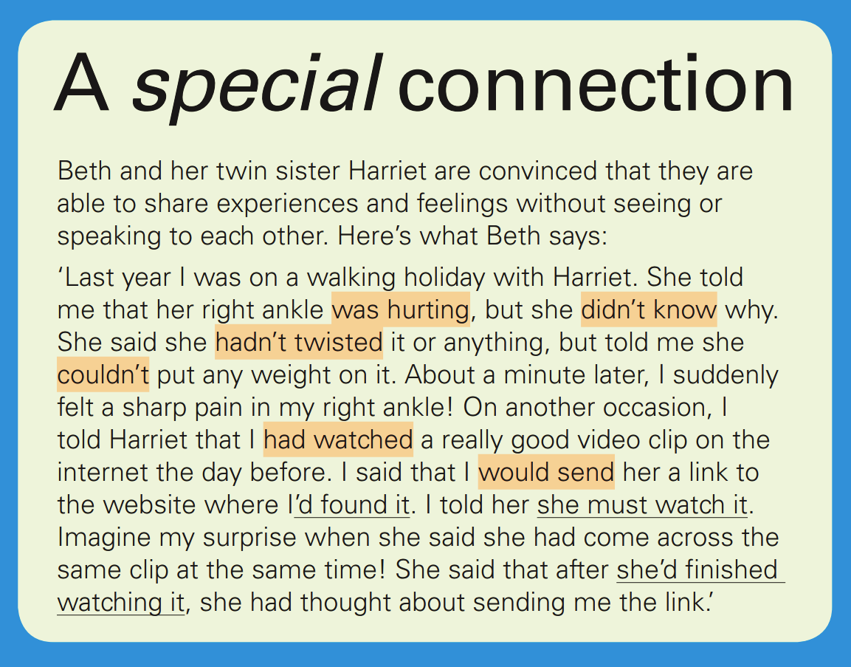
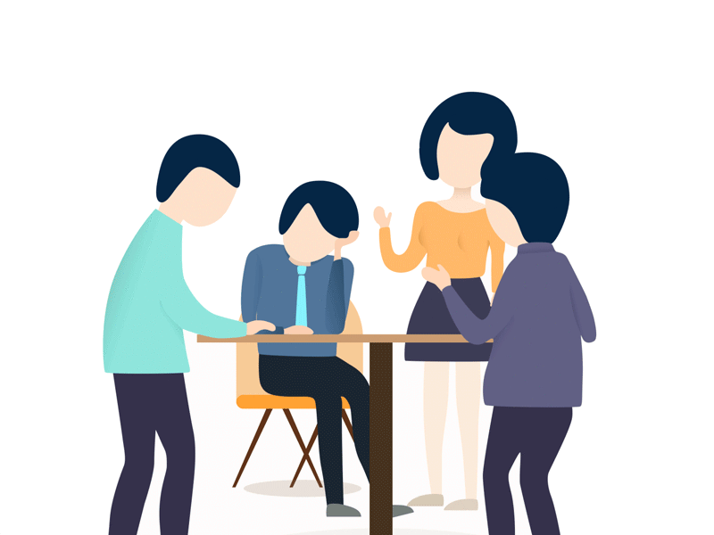
Reading
Discuss in groups and share your ideas
www.phuongnam.edu.vn

Slide 5
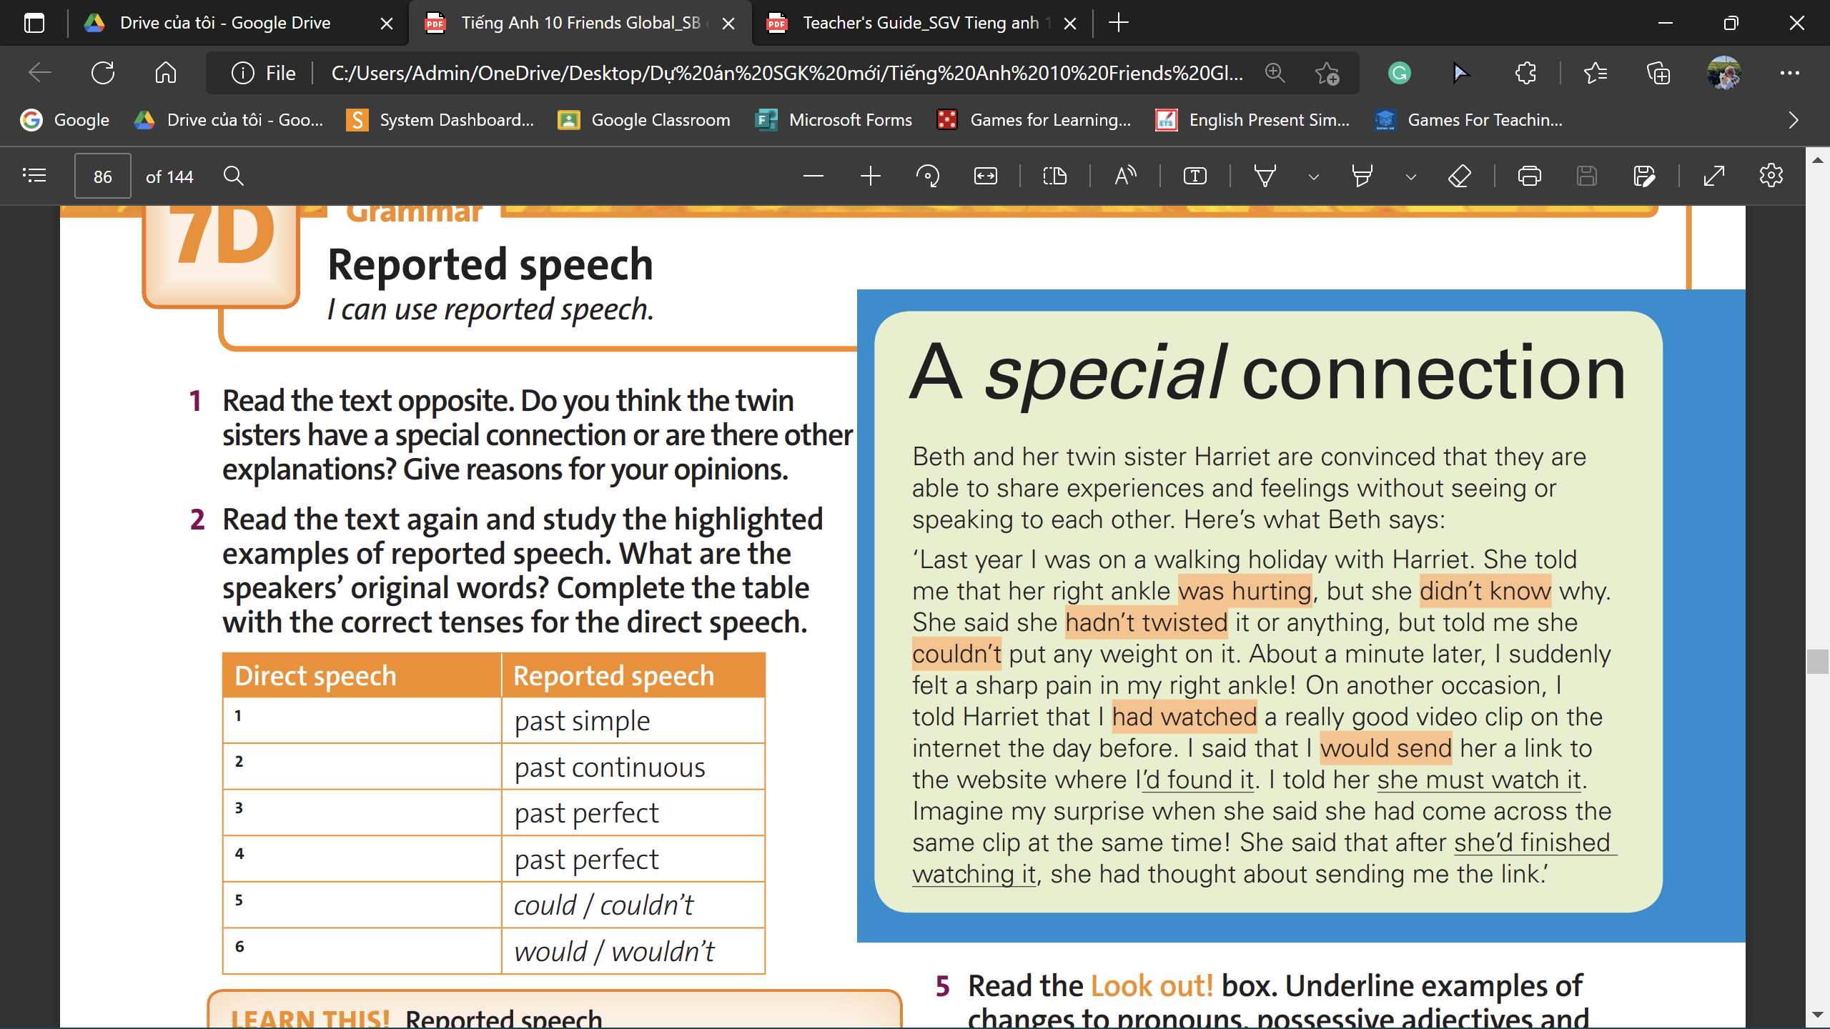
Reading
The speakers’ original words are:
My right ankle is hurting, but I don’t know why. I haven’t twisted it or anything, but I can’t put any weight on it. I watched a really good video clip on the internet yesterday.
I will send you a link to the website where I found it. You must watch it.
www.phuongnam.edu.vn

Slide 6
Reading
BEFORE | AFTER
1. DON’T KNOW | DIDN’T KNOW
2. IS HURTING | WAS HURTING
3. HAVEN’T TWISTED | HADN’T TWISTED
4. WATCH | WATCHED
5. CAN’T PUT | COULDN’T PUT
6. WILL SEND | WOULD SEND
Present Simple
Present Continuous
Present Perfect
Past Simple
Can/ Can’t
Will/ Won’t
www.phuongnam.edu.vn

Slide 7

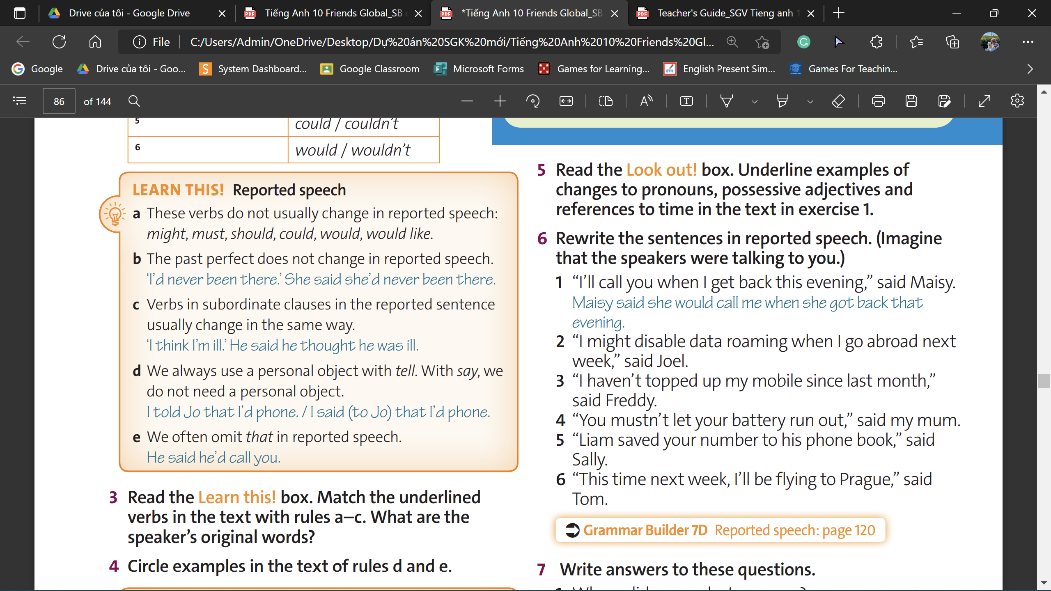
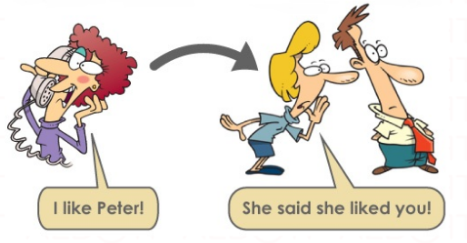
Grammar
Reported Speech
a. she must watch it
b. she’d finished watching it
c. I’d found it
www.phuongnam.edu.vn

Slide 8
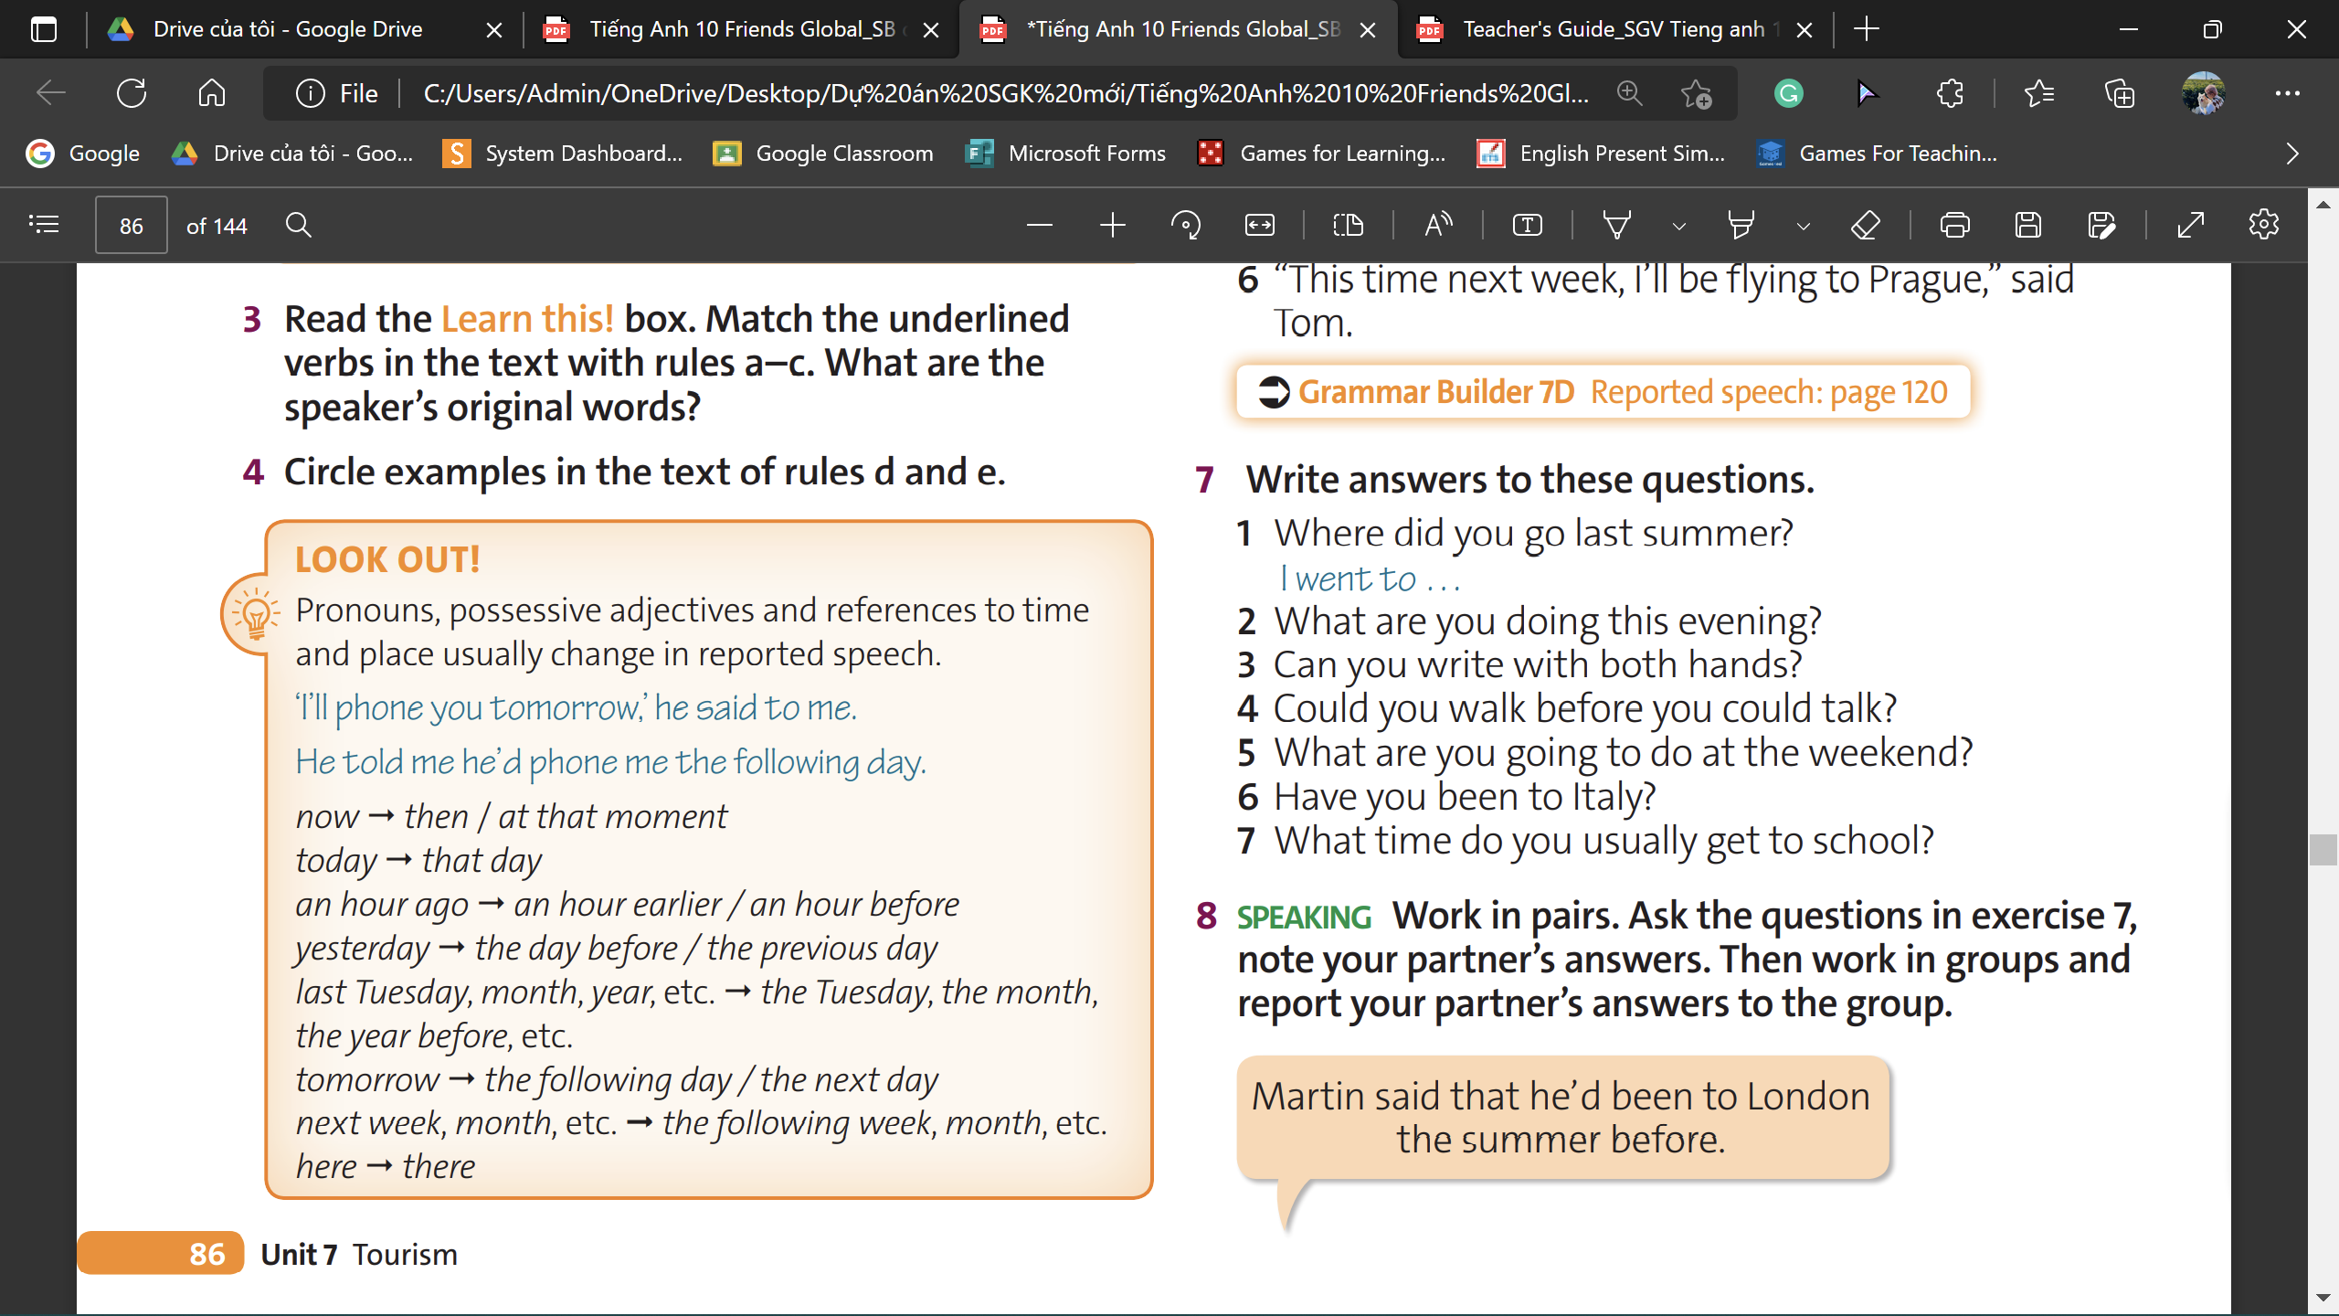
Reading
She told me that her right ankle was hurting ...; She said she hadn’t twisted it. but told me she couldn’t put any weight on it; I told Harriet that I had watched ...; I said that I would send her...; I told her she must watch it; ... she said she had come across the same clip ...; She said that after she’d finished watching it...
She said she hadn’t twisted it. but told me she
couldn’t put any weight on it; I told her she must watch it; ... she said she had come across the same clip ...
www.phuongnam.edu.vn

Slide 9

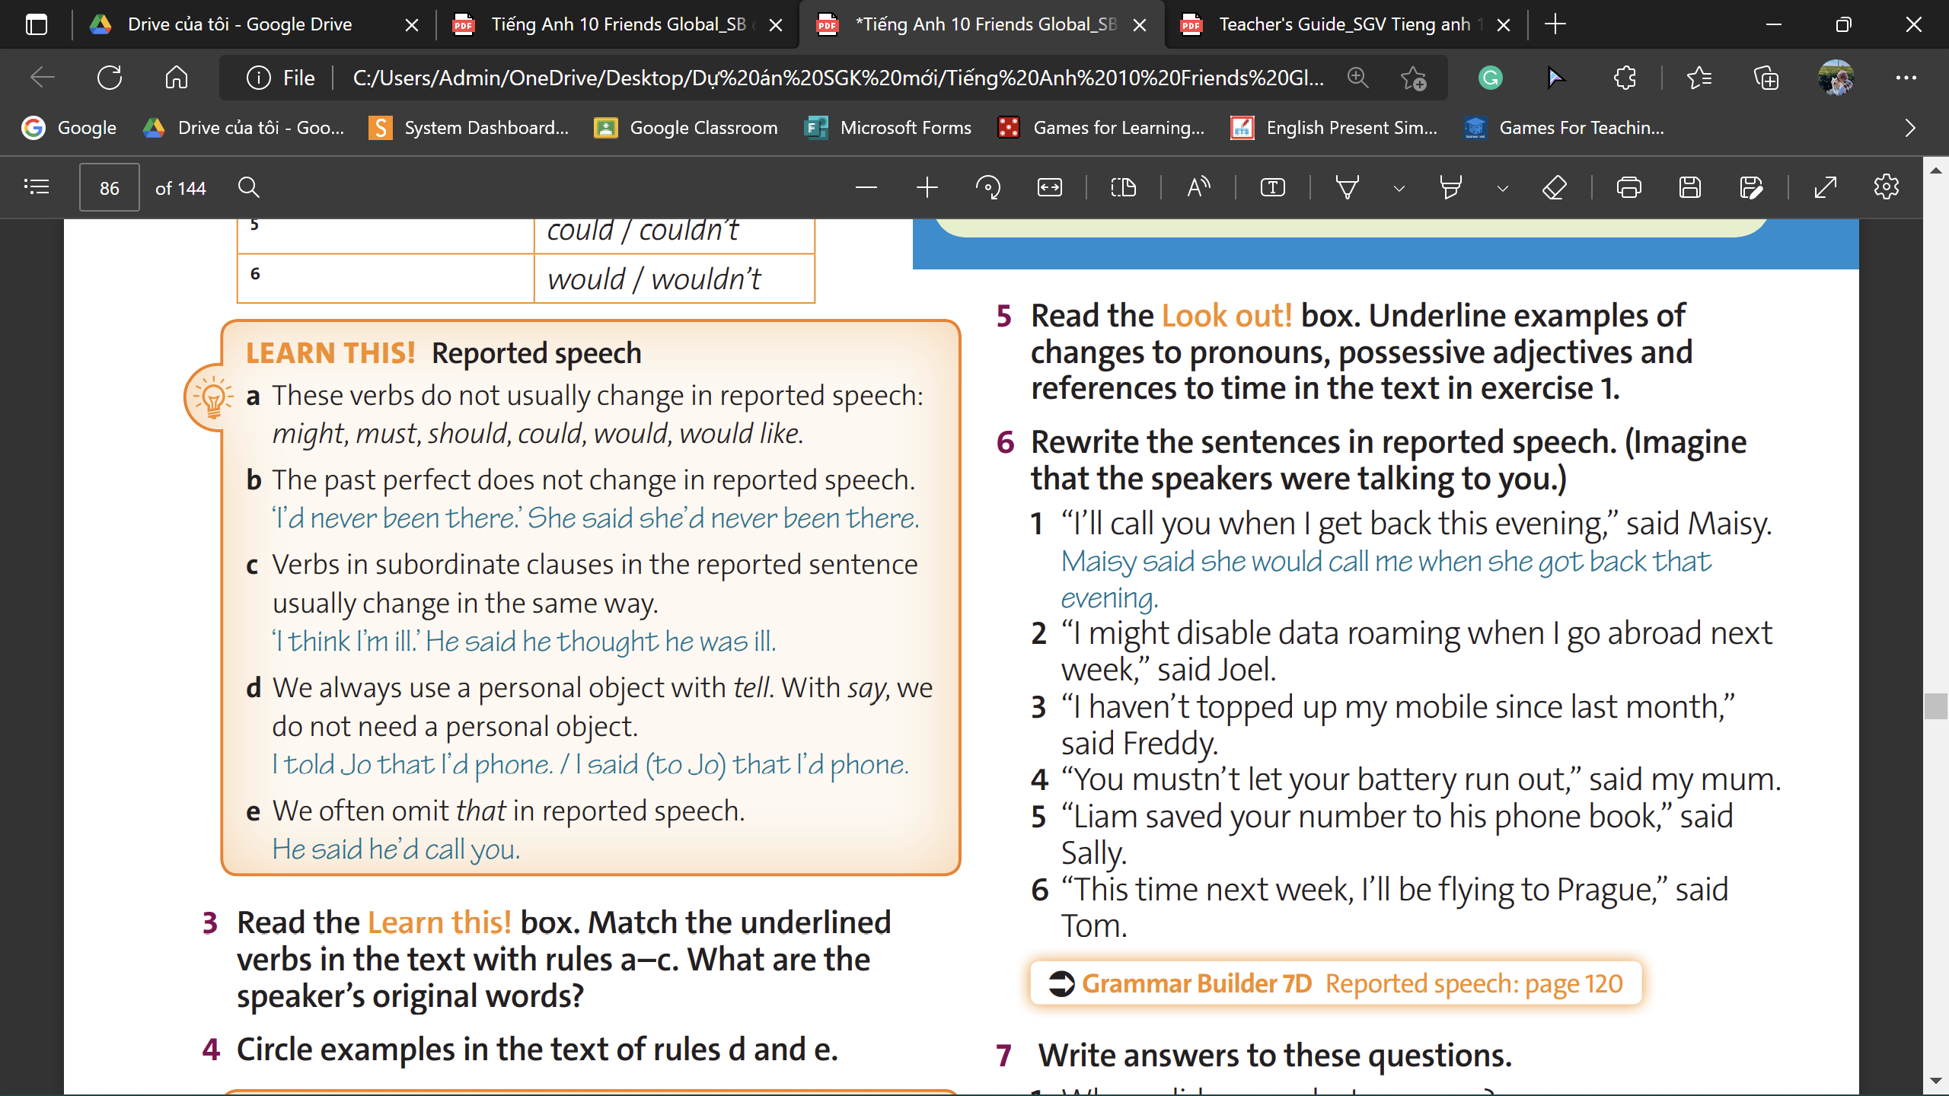
Grammar
Reported Speech
She told me that her right ankle was hurting ...;
She said she hadn’t twisted it... she couldn’t put any weight on it;...
I had watched a really good video clip ... the day before;
I told her she must watch it; she said she had come across ...;
She said that after she’d finished watching it, she had thought about sending me the link.
www.phuongnam.edu.vn

Slide 10
Practice
Answers
2. Joel said (that) he might disable data roaming when he went abroad the following week.
3. Freddy said (that) he hadn’t topped up his mobile since the month before.
4. My mum said (that) I mustn’t let my battery run out.
5. Sally said (that) Liam had saved my number to his phone book.
6. Tom said (that) that/this time the following week, he would be flying to Prague.
www.phuongnam.edu.vn

Slide 11
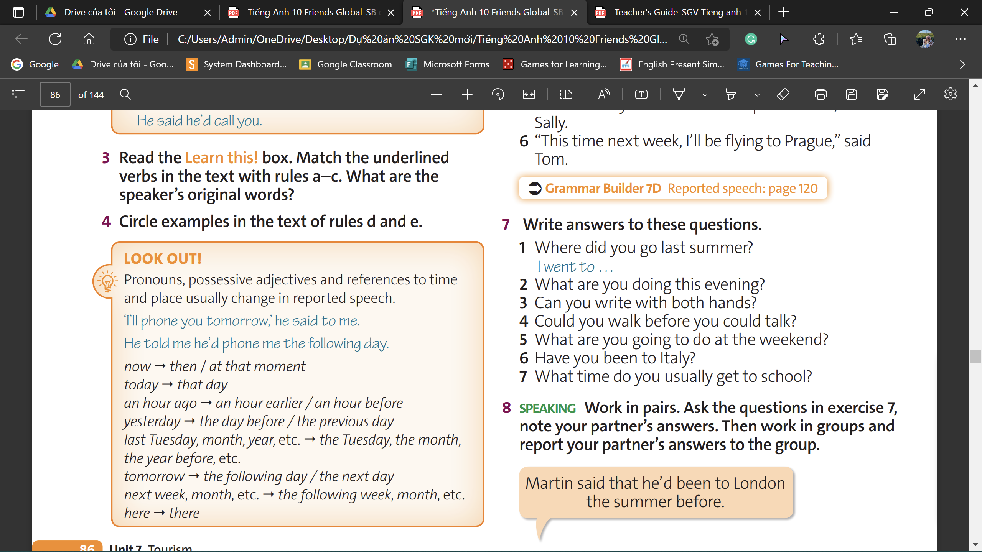
Practice
2. I’m doing …
3. Yes, I can / No, I can’t.
4. Yes, I could / No, I couldn’t
5. I’m going to …
6. Yes, I have / No, I haven’t
7. I usually go to school at …
www.phuongnam.edu.vn

Slide 12

Practice
EX:
www.phuongnam.edu.vn

Slide 13
homework
1. Review the lesson and Reported Speech.
2. Do exercises in Workbook.
3. Prepare U7-E (P.87)

Slide 14

www.phuongnam.edu.vn

Slide 15



Thank you!
CTCP ĐẦU TƯ VÀ PHÁT TRIỂN GIÁO DỤC PHƯƠNG NAM

